Slide 1

Project GreenBox
Creates the perfect environment for plants every time.
Notes:
Hi, I’m Zach Wilcox and today I’ll be presenting on something I call, “Project GreenBox.”

Slide 2
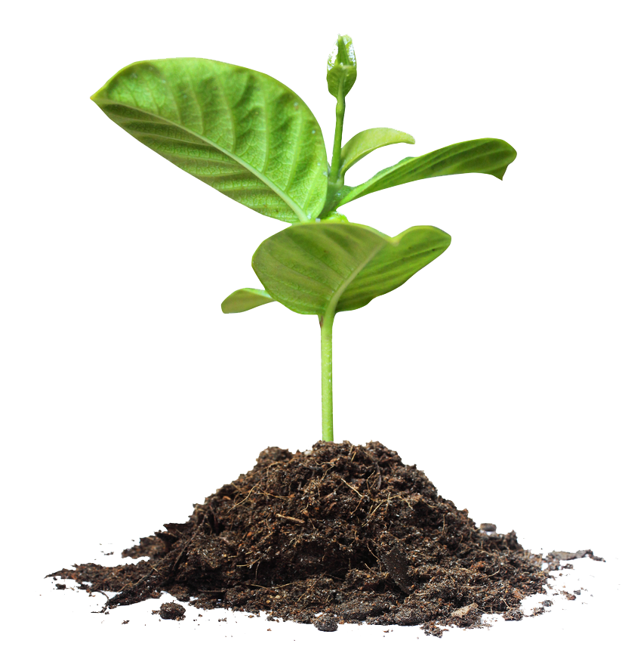
Overview
Introduction
Design details
Project management
Conclusion
Questions
Additional Information
Notes:
“First, a quick overview of the presentation. I will start with…”
What it is and how it’s meant to function
System overview, physical and software design, and a fault tree analysis
Schedule (when things are expected to done), budget (estimations of parts and total)
There is also some additional information at the end of these slides which can be referred to if needed during the questions portion of the presentation.

Slide 3
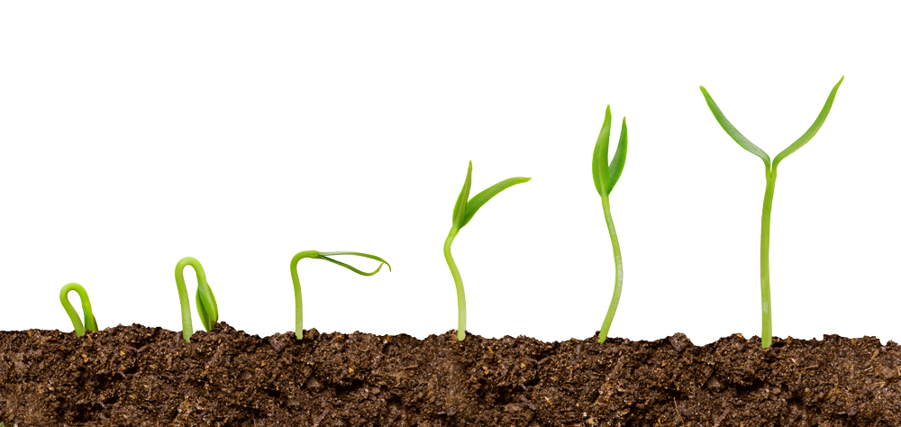
Introduction
Environmental control system
Used to grow plants
2’x2’x2’ box
Modular design
Notes:
It is an environmental control system.
It is created with the purpose of assisting in the growth of plants of all kinds.
For the purpose of this project, a 2x2x2 box sized version will be implemented.
Due to the size of this implementation, it will mainly be used for small plants or plants in the very early stages of growth.
The original intention for this project was to create a control system that could be scaled to match the needs of the consumer. (greenhouses and such).
To stay consistent with the idea of scalability, a modular design is used in creating this box.
It will implement already existing heating, cooling, humidifying, dehumidifying, and lighting systems as much as possible. (no need to reinvent the wheel if possible)

Slide 4
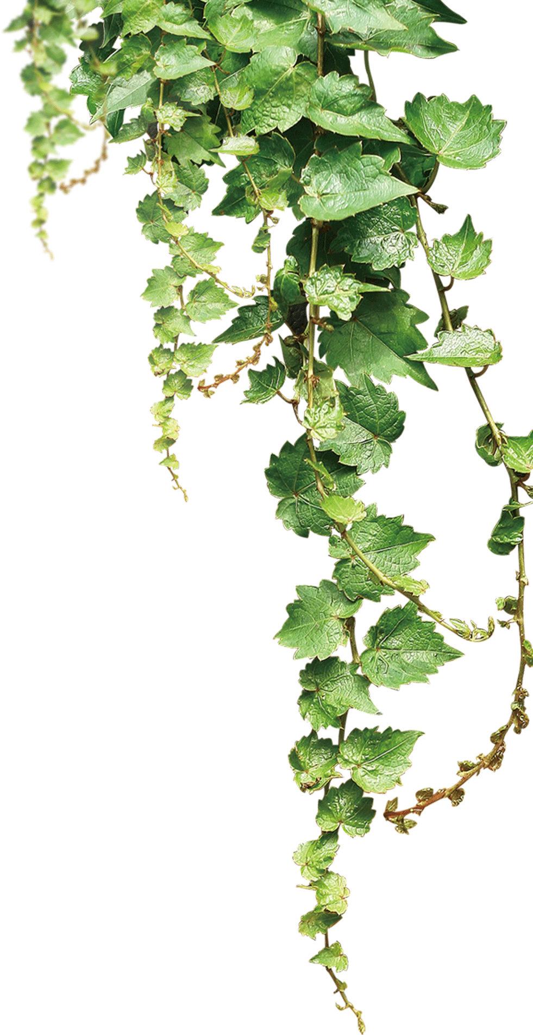
Problem
Specific conditions needed
Time-consuming
Hard to maintain
No ‘Green thumb’
Notes:
So, a quick background on how I came up with this idea…
Story of growing up gardening, watering/sunning tomatoes growing up.
Enjoy the process, and especially the results, but I don’t exactly have a “green thumb”
Current gardening
House plants
Gourmet mushrooms (particularly finnicky)

Slide 5
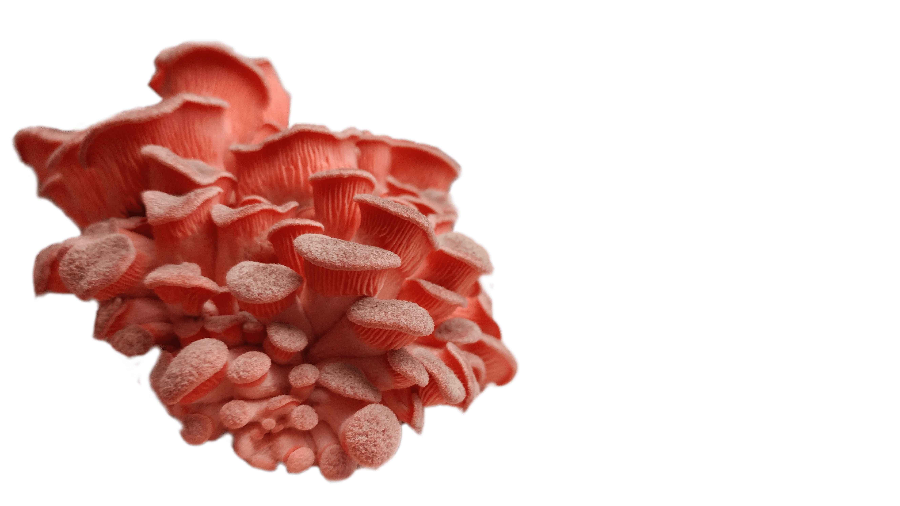
Project Impact
Ideal conditions
Simplicity
Less time
Less effort
Success for beginners
Notes:
It will be my artificial “green thumb” (rejected name for this project)
Allow people to raise plants in ideal conditions without putting in excessive time or effort
Easily grow things such as vegetables, house plants, mushrooms, and flowers.

Slide 6
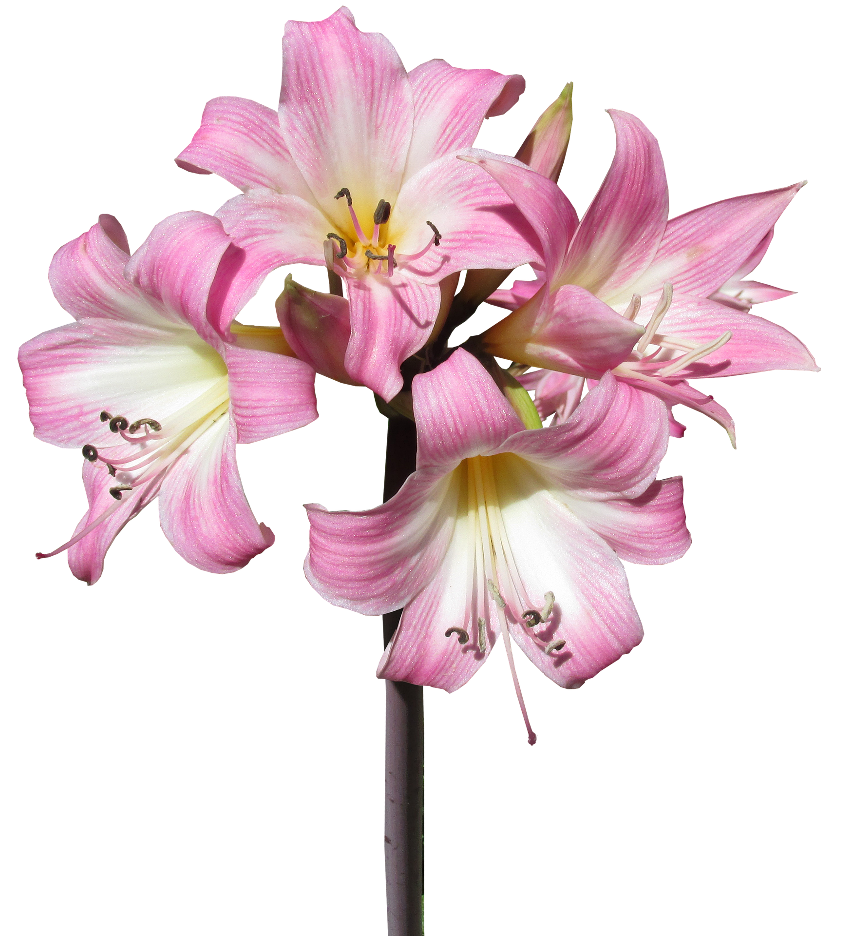
Design Details
System overview
Physical design
Software design
Fault tree analysis diagram

Slide 7
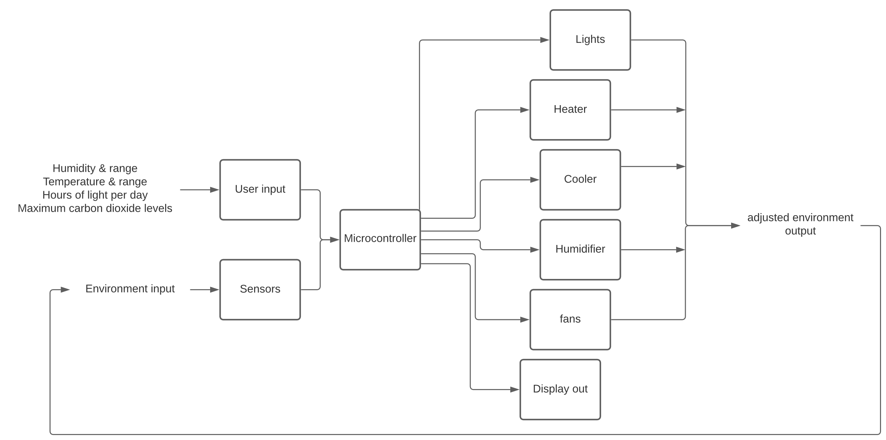
System Overview
Notes:
Two types of input: user, and environmental

Slide 8
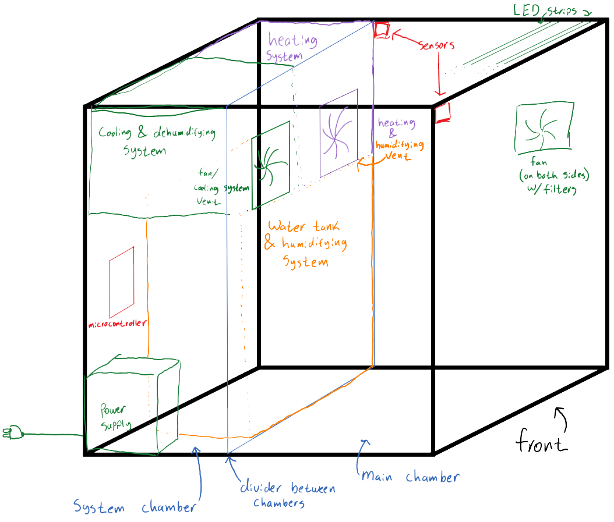
Physical Design
Notes:
All interface between main chamber and system chamber are higher up to avoid water damage to electrical components.
Touch on circuit design (5v relays to control power supply to each system, for modularity’s sake)
Likely going to be power strip / 5V relays

Slide 9
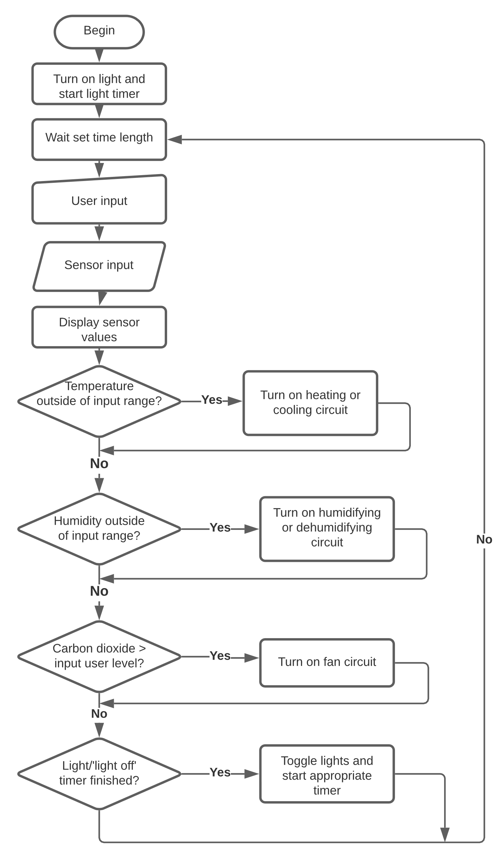
Software Design
Notes:
Software can be broken down into a sample->compare->adjust cycle
User input will be used in the calculations for ranges. As a potentiometer is used, it can be adjusted on the go, though the chart doesn’t show it being sampled each cycle.
Sample time TBD, likely 10-30 seconds or so. Likely will need to be adjusted depending on insulation of box.

Slide 10
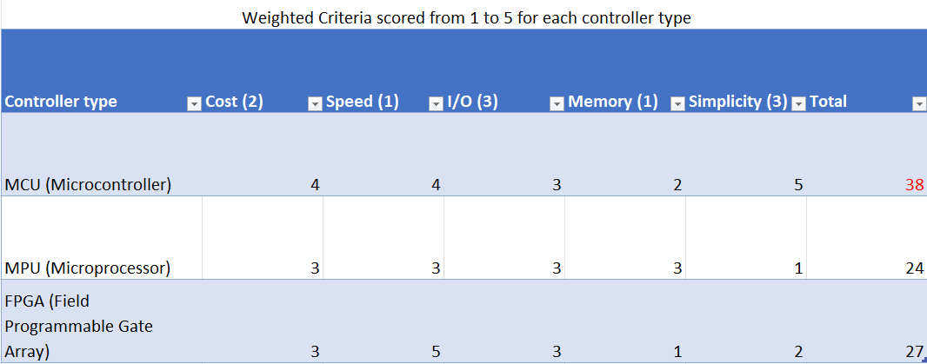
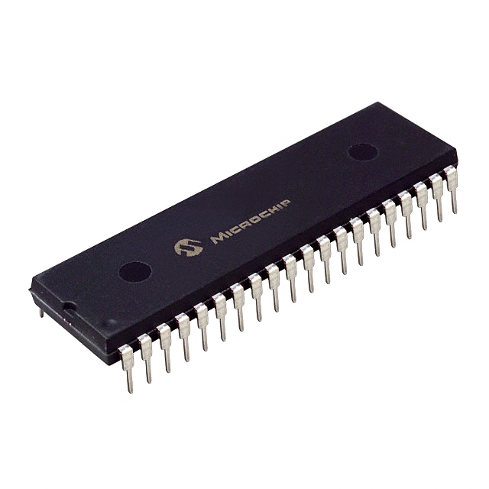
Design details: Controller
Notes:
Memory refers to flash memory for storage of program. I/O doesn’t require significant amounts of memory.

Slide 11
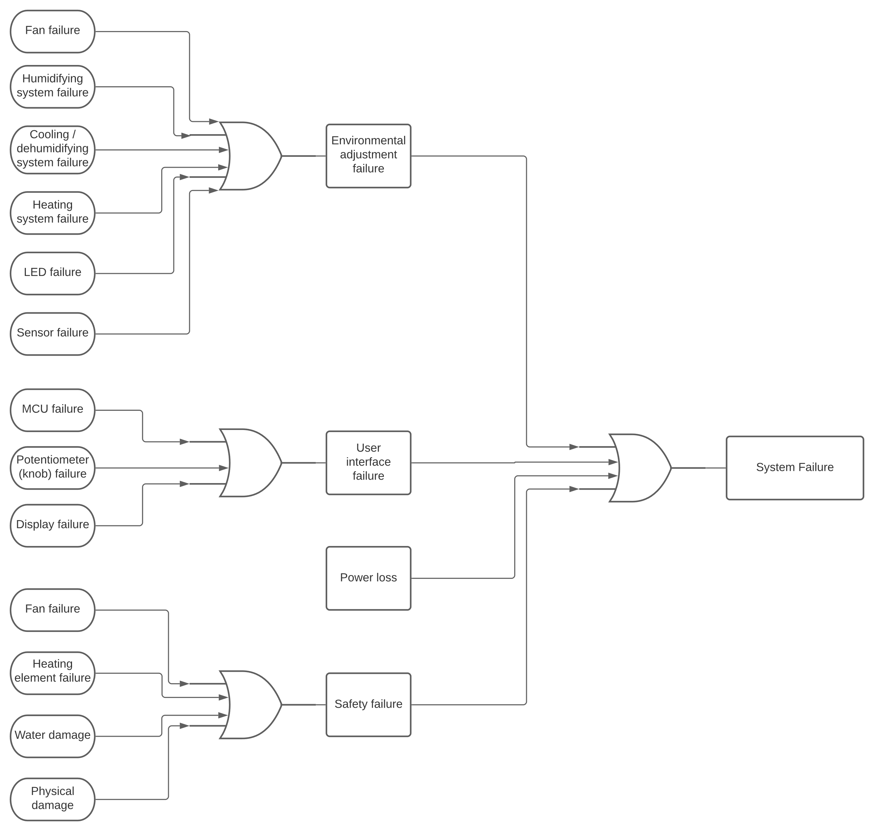
Fault Tree Analysis
Notes:
Four main categories of failure: Functional, I/O, Power, Safety
Electricity is main concern for water damage portion of safety
MCU failure and physical damage can result in any/all failure categories
Not included: MCU for environmental

Slide 12
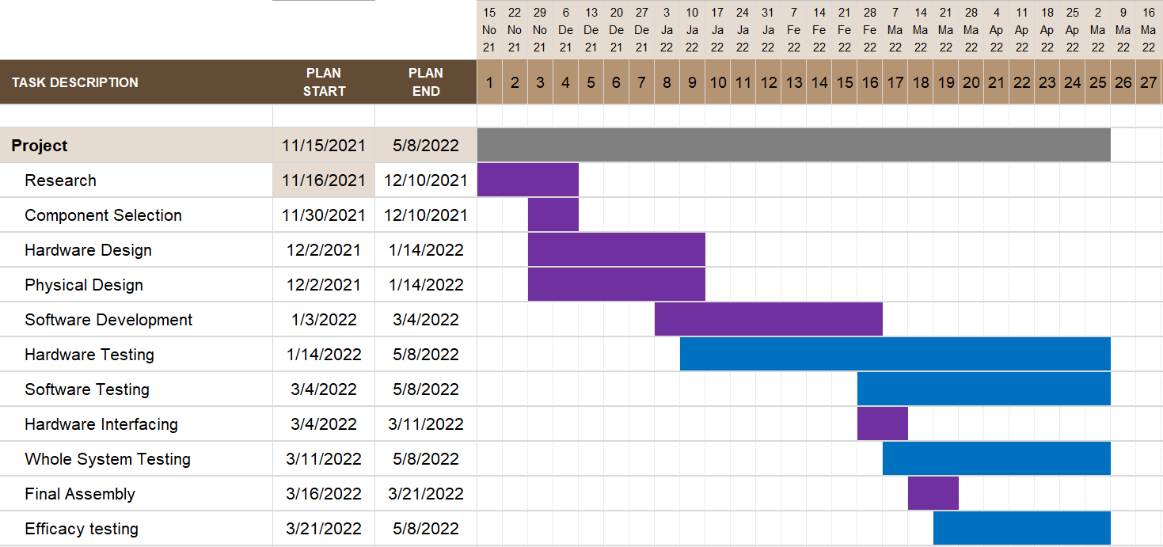
Schedule
Notes:
Testing is marked blue, and all types of testing are continued through to the end of the project
Currently midway through hardware and physical design
Software development to begin at the start of the year

Slide 13
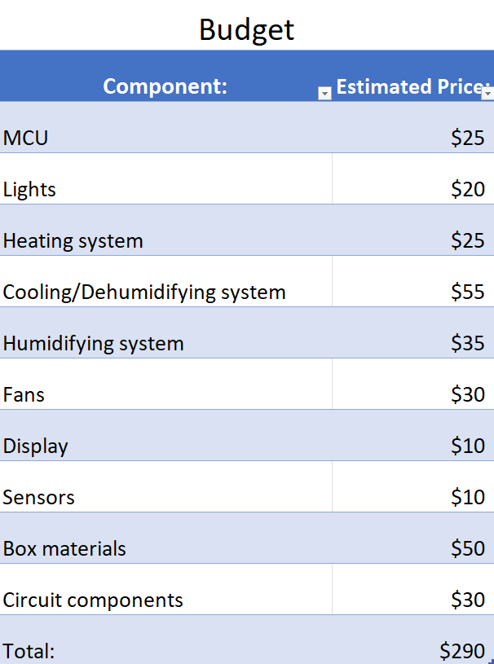
Budget
Notes:
Estimates, obviously.

Slide 14
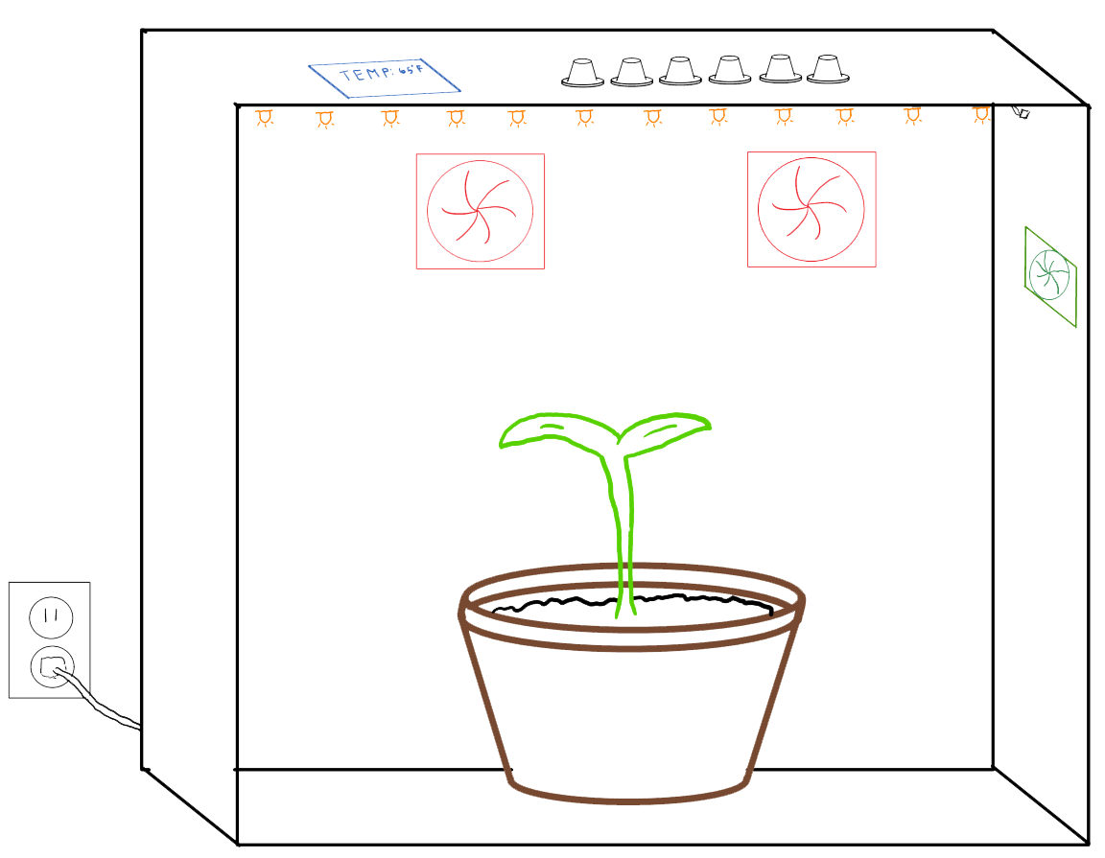
Conclusion
Notes:
Conclusion, this will provide a very simple way to ensure an ideal environment for any beginner or enthusiast looking to get into growing!
For simplicity’s sake, watering is not included, though it was considered and could be implemented in future versions.
A timer for soil exchange is also loosely considered.

Slide 15
Questions?
Notes:
Questions?

Slide 16
References (photos):
https://wallup.net/nature-plants-flowers-macro-depth-of-field-rose-yellow-flowers-yellow-black-background/
https://cdn2.hubspot.net/hubfs/242200/blog_images/business-growth-im.png#keepProtocol
https://www.htgsupply.com/wp-content/uploads/2019/05/shutterstock_189737078.png
https://duckduckgo.com/?q=flower&atb=v276-1&iar=images&iaf=size%3ALarge%2Ctype%3Atransparent&iax=images&ia=images&iai=https%3A%2F%2Fsnipstock.com%2Fassets%2Fcdn%2Fpng%2F4982c45b2096ce79ac3f2095c7c75df2.png
https://i1.wp.com/freshniagaramushrooms.com/wp-content/uploads/2020/01/Pink-Oyster-Mushroom-2.png?fit=5312%2C2988&ssl=1
https://duckduckgo.com/?q=humidity+sensor&atb=v276-1&iax=images&ia=images&iaf=type%3Atransparent&iai=https%3A%2F%2Firishelectronics.ie%2FWebRoot%2FRegister365%2FShops%2F950018241%2F5512%2F9F16%2F0EC0%2F6307%2FB4FD%2FC0A8%2F190D%2FBE7F%2Fdht-11.png
https://duckduckgo.com/?q=light+strip&atb=v276-1&iar=images&iaf=type%3Atransparent&iax=images&ia=images&iai=https%3A%2F%2Fsc01.alicdn.com%2Fkf%2FHTB1oU1HhbSYBuNjSspf763ZCpXaZ%2F231587680%2FHTB1oU1HhbSYBuNjSspf763ZCpXaZ.png
https://duckduckgo.com/?q=peltier&atb=v276-1&iar=images&iaf=type%3Atransparent&iax=images&ia=images&iai=https%3A%2F%2Fcdn-reichelt.de%2Fbilder%2Fweb%2Fxxl_ws%2FC800%2FTB_31_1-0.png
https://duckduckgo.com/?q=microcontroller&atb=v276-1&iax=images&ia=images&iaf=type%3Atransparent%2Csize%3ALarge&iai=http%3A%2F%2Fwww.pngmart.com%2Ffiles%2F7%2FMicrocontroller-Transparent-Background.png

Slide 17
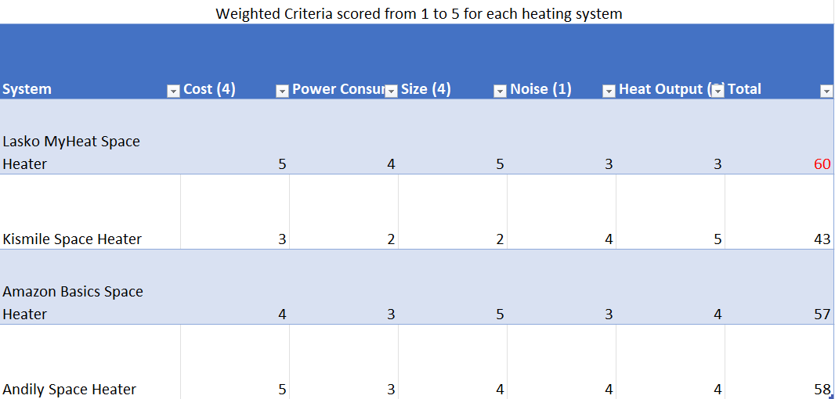
Design details: heating system
Notes:
Maybe change to consider different types of heaters such as heating pad, simple heating element and fan etc..

Slide 18
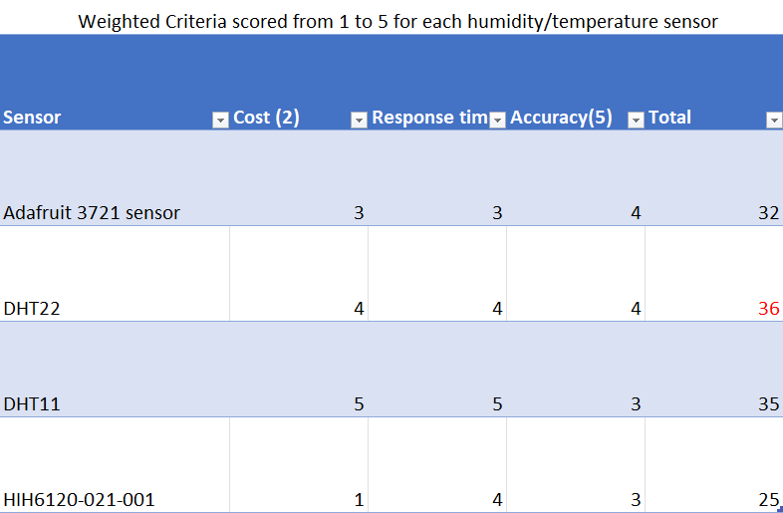
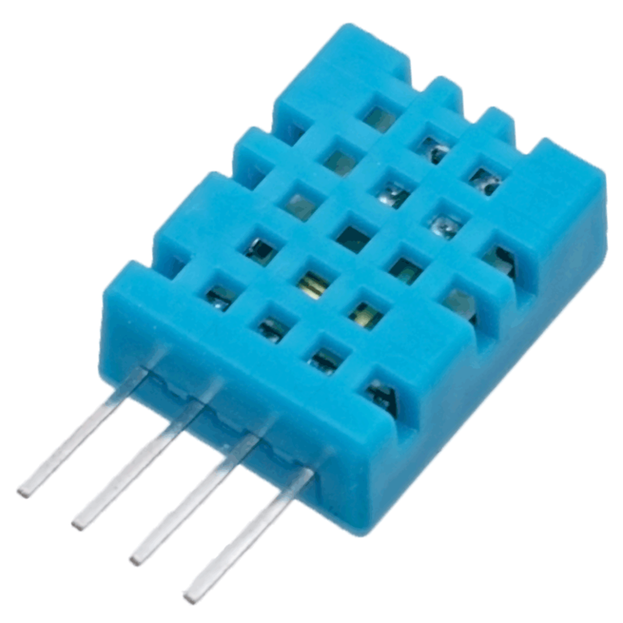
Design details: temperature/humidity sensors
Notes:
Same Problem as display; maybe don’t include as parts are so specific. Maybe add pictures?

Slide 19
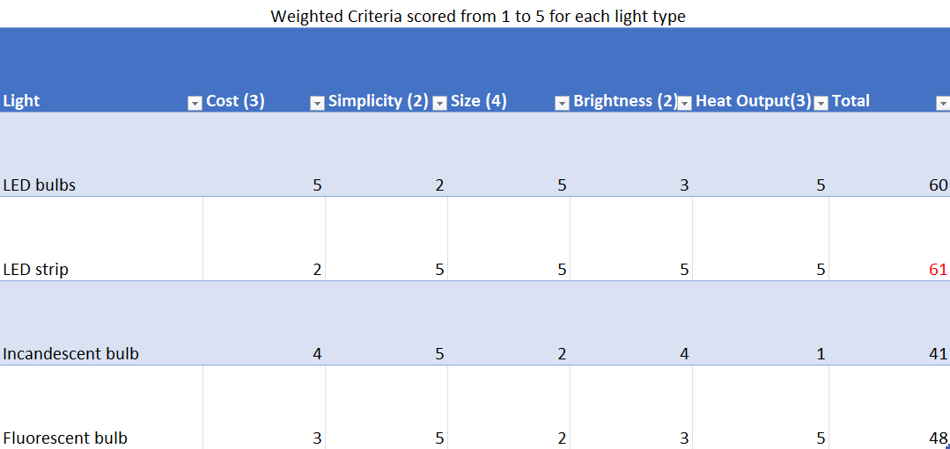
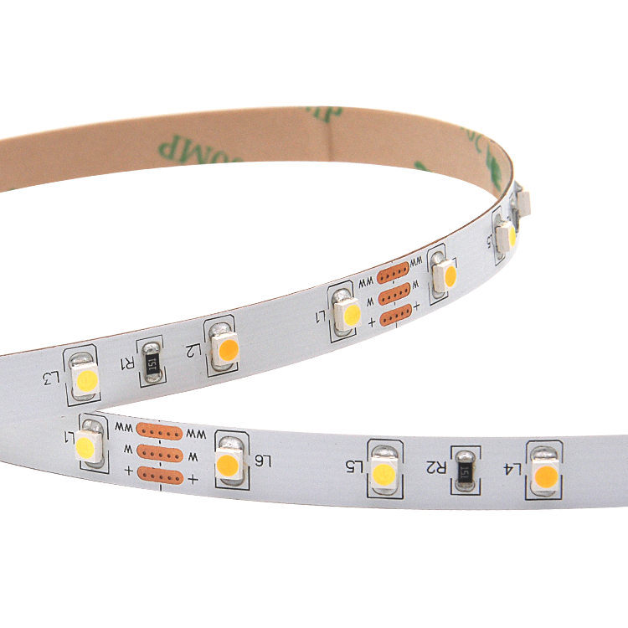
Design details: Lights
Notes:
Maybe add a simplicity criteria? It may change the outcome.
Increase font size

Slide 20
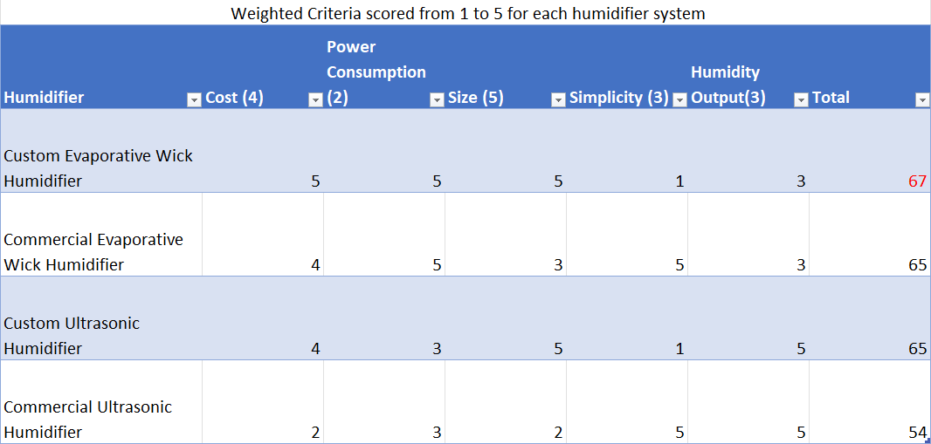
Design details: Humidifier
Notes:
Describe basic mechanism of each humidifier, and final decision reasoning

Slide 21
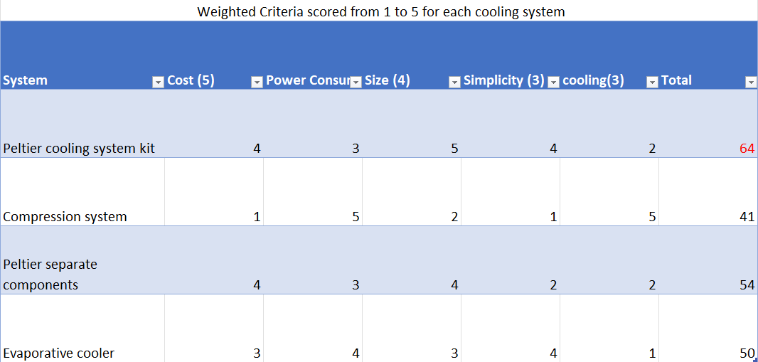
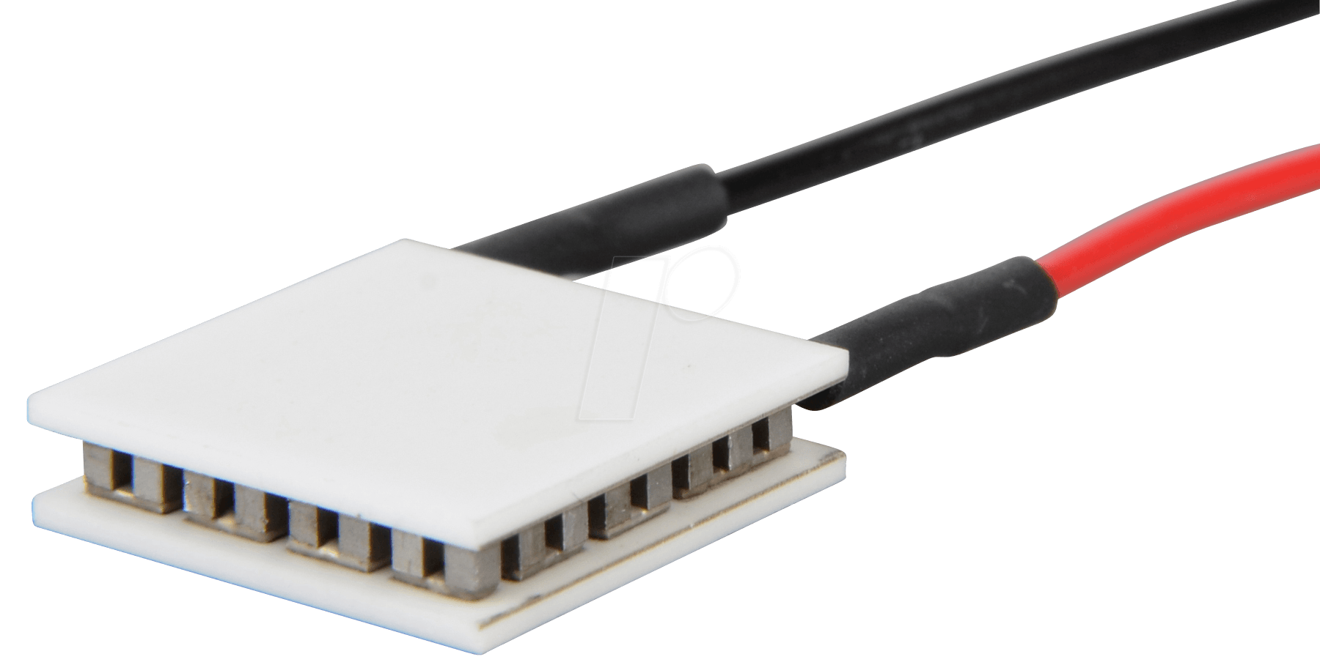
Design details: cooling system
Notes:
Explain each system’s basic mechanisms and final reasoning (cost was biggest factor here)
As the final cooling/dehumidifying effect won’t be super strong, the specs may have to be modified.

Slide 22
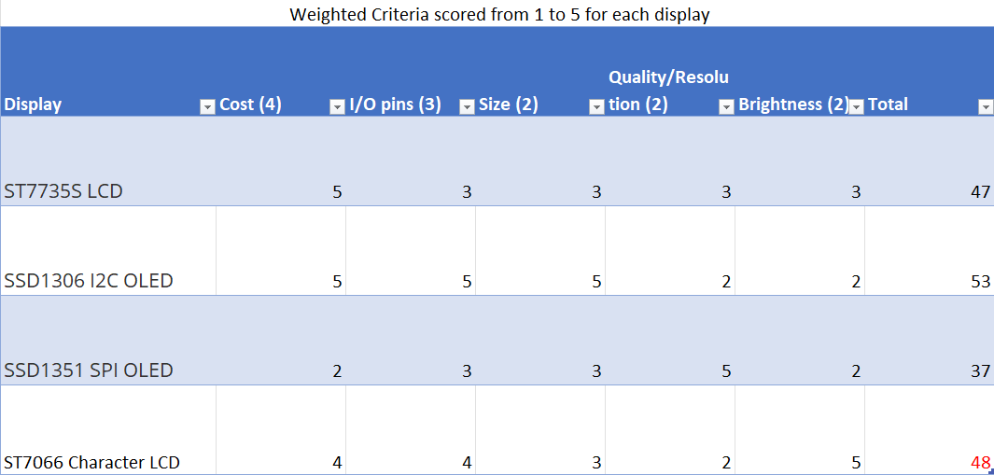
Design details: display
Notes:
Maybe need pictures, maybe not include since parts are so specific? Ask professor.

